Slide 1
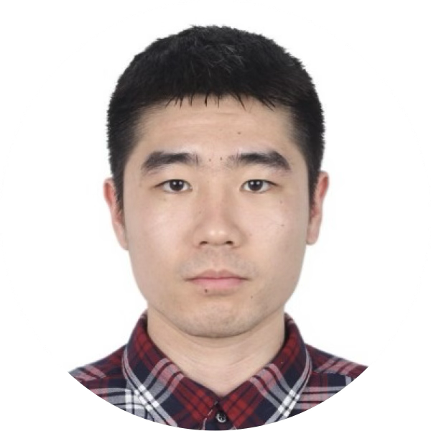
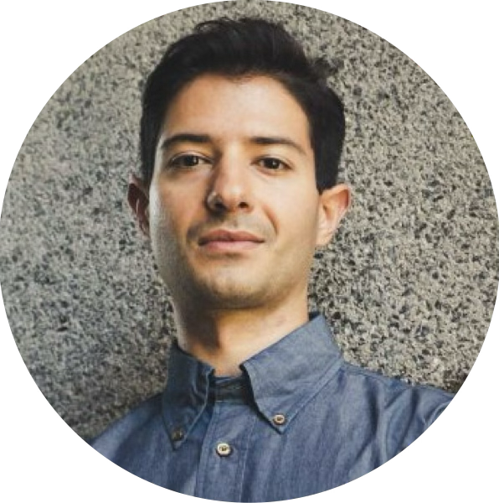
No-Regret Model Predictive Control
with Online Learning of Koopman Operators
Hongyu Zhou, Vasileios Tzoumas

Slide 2

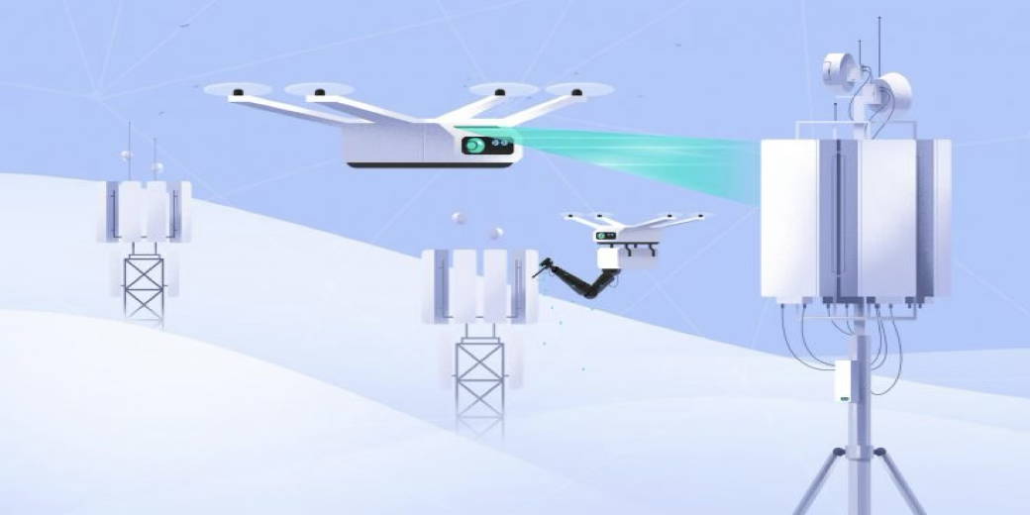
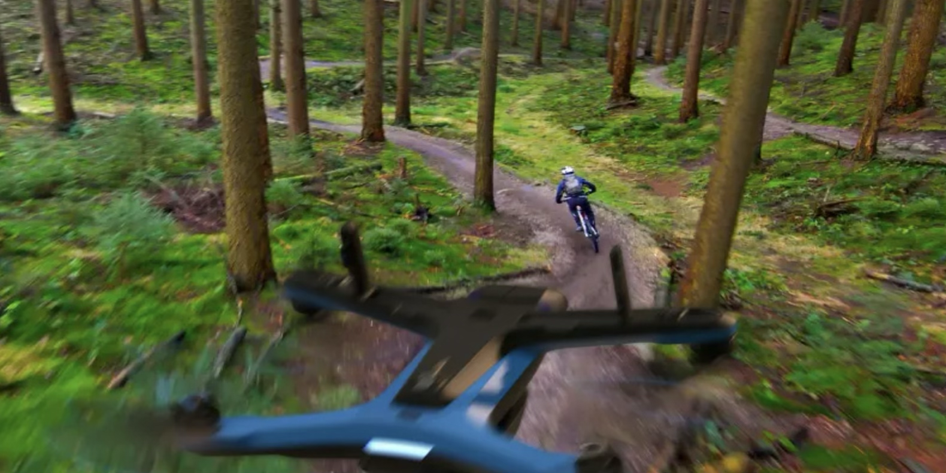
Robots That Adapt Continuously Across Tasks & Domains
Drone Delivery
Inspection & Maintenance
Target Tracking
Goal: Generate control inputs to achieve agile and accurate motion control across tasks & domains.^{1,2,3}
Challenges: Dynamics and/or disturbances that are unknown, difficult-to-model, adaptive:
Drone delivery: Packages with unknown weights.
Inspection and maintenance: Wind, drag, ground effects.
Target tracking: Targets with unknown dynamics.
¹ Ackerman, IEEE Spectrum '13
² Chen, Liu, Shen, IROS '16
³ Seneviratne, Dammika, et al., Acta Imeko '18

Slide 3
Robots That Learn Continuously Across Tasks & Domains
Lifelong/Continual Learning
Isolated/Self-supervised Learning
Increasing
Difficulty & Autonomy
On-the-fly/Online Adaptation
Focus of this work

Slide 4
Model Predictive Control Under Uncertainty
All above scenarios are control problems under uncertainty
Goal: Find control input to minimize a look-ahead cumulative loss:
convex
known system dynamics
unknown uncertainty
control constraints

Slide 5
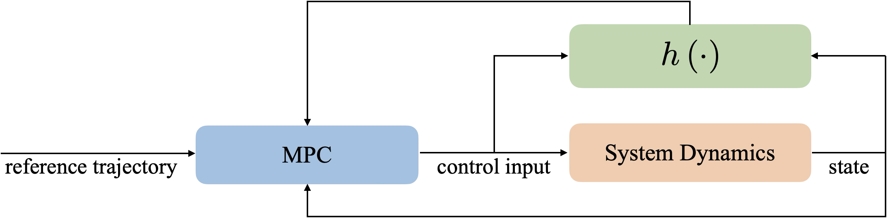
Model Predictive Control Under Uncertainty
All above scenarios are control problems under uncertainty
Goal: Find control input to minimize a look-ahead cumulative loss:
convex
known system dynamics
unknown uncertainty
control constraints
Ideally: if is known:

Slide 6
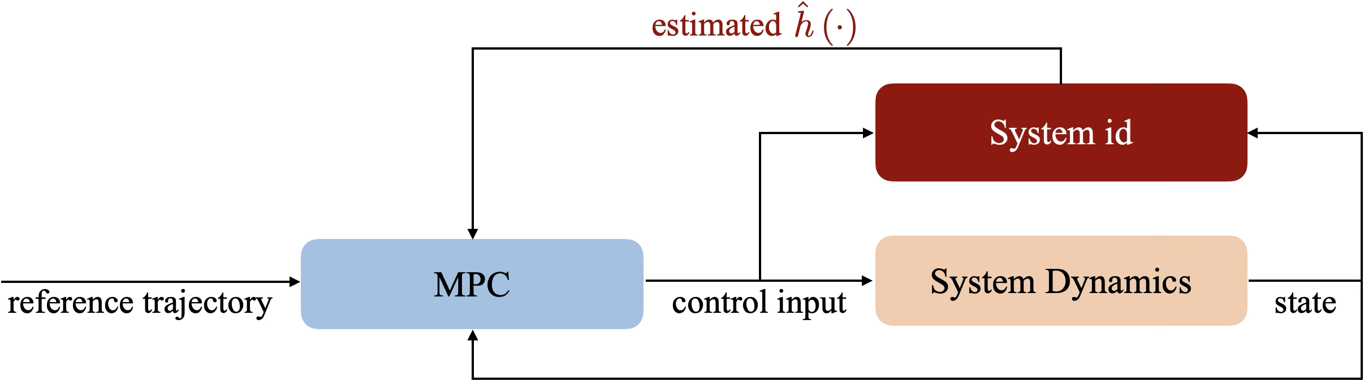
Model Predictive Control Under Uncertainty
All above scenarios are control problems under uncertainty
Goal: Find control input to minimize a look-ahead cumulative loss:
convex
known system dynamics
unknown uncertainty
control constraints
But is unknown:

Slide 7
System Identification given a Function Basis
Goal: Find online
Example:
Reproducing Kernels in Hilbert Spaces: Universal approximation theorem:⁴
[Zhou and Tzoumas, TRO '25]
Neural Networks: Similarly to above but where:
Koopman Observables:
[This paper, ACC '25]
⁴ Boffi et al, JMLR '22
Notes:
\textbf{Assume:} Koopman observable function $\Phi$ and $\Psi$ such that
\begin{align*}
\Phi\left(h\left(z_{t}\right)\right) &\triangleq A \Phi\left(h\left(z_{t-1}\right)\right) + B \Psi\left(h\left(z_{t-1}\right), z_{t}\right) \\
h\left(z_{t}\right) &\triangleq C \Phi\left(h\left(z_{t}\right)\right)
\end{align*}
where $\Phi\left( \cdot \right)$ is locally Lipschitz, $\Psi\left( \cdot, \cdot \right)$ is uniformly bounded, \mbox{and $C$ a constant matrix.}

Slide 8
System Identification given a Function Basis
Goal: Find online
Example:
Reproducing Kernels in Hilbert Spaces: Universal approximation theorem:⁴
[Zhou and Tzoumas, TRO '25]
Neural Networks: Similarly to above but where:
Koopman Observables:
[This paper, ACC '25]
⁴ Boffi, et al, JMLR '22

Slide 9

Simultaneous System Identification and Model Predictive Control
i.e., update estimate of

Slide 10
Suboptimality Metric against Optimal Control Policies in Hindsight

Slide 11
State of the Art
⁵
⁶
⁷
⁵ Sánchez-Sánchez et al., '18; Carron et al., RAL '19; Torrente et al., RAL '21; Shi et al., ICRA '19; O’Connell, et al., SR '22; …
⁶ Goel et al., '20; Sabag et al., ACC '21; Goel et al., L4DC '21; Martin et al., L4DC '22; Didier et al., L-CSS '22; Zhou et al., CDC '23; …
⁷ Slotine, '91; Krstic, et al., '95; Ioannou et al., '96; Tal et al., TCST '20; Wu, et al., '23; Das et al., '24; Jia, et al., TRO '23; …

Slide 12
State of the Art
⁸
⁹
⁸ Agarwal et al., ICML '19; Hazan et al., ALT '20; Gradu et al., L4DC '23; Zhou et al., CDC '23; Zhou et al., RAL '23; ...
⁹ Brunton et al., IFAC '16; Proctor et al., SIADS '16; Proctor et al., SIADS '18; Korda et al., Automatica '18; Bruder et al., TRO '20; ...
Notes:
\textbf{Koopman Operator for Control}
\begin{itemize}[leftmargin=42pt]
\item represents a nonlinear dynamical system as a linear system by \mbox{evolving observable functions}
\begin{itemize}
\item often focus on full dynamics instead of residual dynamics
\item do not provide regret analysis
\end{itemize}
\end{itemize}

Slide 13
Algorithm: Simultaneous Koopman Learning and MPC
Notes:
\noindent \textbf{Initialization:}
\begin{itemize}[leftmargin=22pt]
\item \mbox{Koopman observable functions $\Phi$ and $\Psi$; domain set $\mathcal{D}$; gradient descent learning rate $\eta$;}
\vspace{3mm}
\end{itemize}
\noindent \textbf{At each iteration} $t=1,\; ...\;, T$:
\begin{enumerate}
\item Apply control input $u_t$ using MPC with \cMNB{${h}\left(\cdot, \cdot; \hat{\alpha}_{t}\right) \triangleq C \left( \hat{A}_{t} \Phi\left( \cdot \right) + \hat{B}_{t} \Psi\left( \cdot, \cdot \right) \right)$};
\item Observe state $x_{t+1}$, and calculate disturbance \mbox{via \cPR{$h\left(z_t\right) = x_{t+1} - f(x_{t}) - g(x_{t}) u_{t}$};}
\item Formulate estimation loss $l_t\left(\hat{\alpha}_t\right) \triangleq \left\| \cPR{\Phi\left(h\left(z_t\right)\right)} - \cMNB{\left( \hat{A}_{t} \Phi\left(h\left(z_{t-1}\right)\right) + \hat{B}_{t} \Psi\left( h\left(z_{t-1}\right), z_{t} \right) \right)} \right\|^2$;
\item Calculate gradient \cMG{$\nabla_t \triangleq \nabla_{\hat{\alpha}_t} l_t\left(\hat{\alpha}_t\right)$};
\item Update $\cMP{\hat{\alpha}_{t+1}^\prime}= \cMPK{\hat{\alpha}_t} - \eta \cMG{\nabla_t}$;
\item Project $\cMP{\hat{\alpha}_{i,t+1}^\prime}$ onto $\mathcal{D}$, \emph{i.e.}, $\cMPK{\hat{\alpha}_{i,t+1}} = \Pi_{\mathcal{D}}(\cMP{\hat{\alpha}_{i,t+1}^\prime})$, for $i \in \{1, \; \dots, \; M\}$.
\end{enumerate}

Slide 14
No Dynamic Regret
Theorem [TRO '25]
Zhou and Tzoumas. "Simultaneous system identification and model predictive control with no dynamic regret." IEEE Transactions on Robotics (2025).
Notes:
\noindent \textbf{Technical Assumptions:}
\begin{itemize}
\item Lipschitzness of $c_{t}\left(\cdot, \cdot\right)$ and $\hat{h}\left(\cdot\right)$.
\item Stability of MPC for the estimated system.
\end{itemize}

Slide 15
Assumptions
Definition (Value Function¹⁰)
¹⁰ Grimm, et al, TAC '05

Slide 16
Assumptions
Assumption (Stability Condition)
¹⁰
¹⁰ Grimm, et al, TAC '05

Slide 17
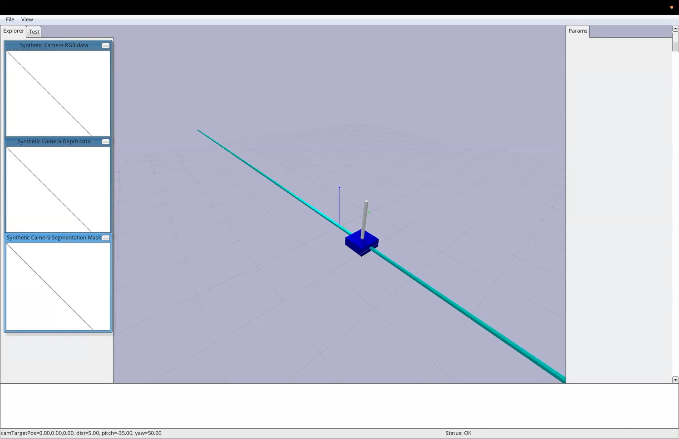
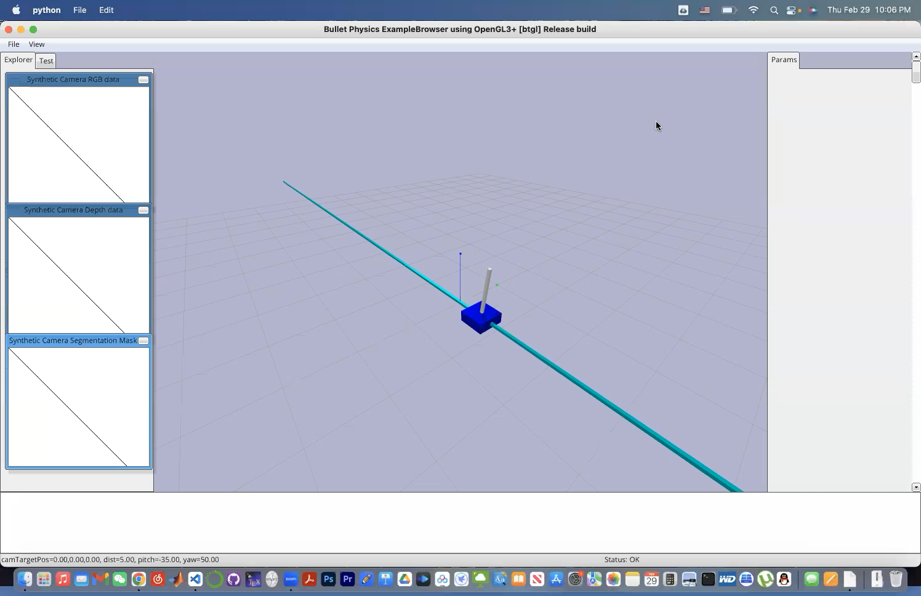

Simulations on Cart-Pole Stabilization with Inaccurate Model
Goal:
Stabilize the cart-pole around the upright position of the pole
Setup:
The model parameters (pole length & mass, cart mass) are inaccurate
Compared algorithms: (i) Random Fourier Feature MPC¹¹ and (ii) Gaussian Process MPC¹²
Ours
RFF-MPC
GP-MPC
¹¹ Zhou et al., TRO '25
¹² Hewing et al., TCST '19

Slide 18
Our Algorithm Achieves Fastest Stabilization (25% Inaccuracy)
Sample Trajectory
Stabilization Error

Slide 19
Our Algorithm Achieves Fastest Stabilization (25% Inaccuracy)
One-Step Prediction Error
Results:
Prediction error decreases as we collect more data
Fastest stabilization due to lowest prediction error

Slide 20
Our Algorithm Achieves Fastest Stabilization (45% Inaccuracy)
Sample Trajectory
Results:
Ours achieves successful stabilization while other methods fail

Slide 21
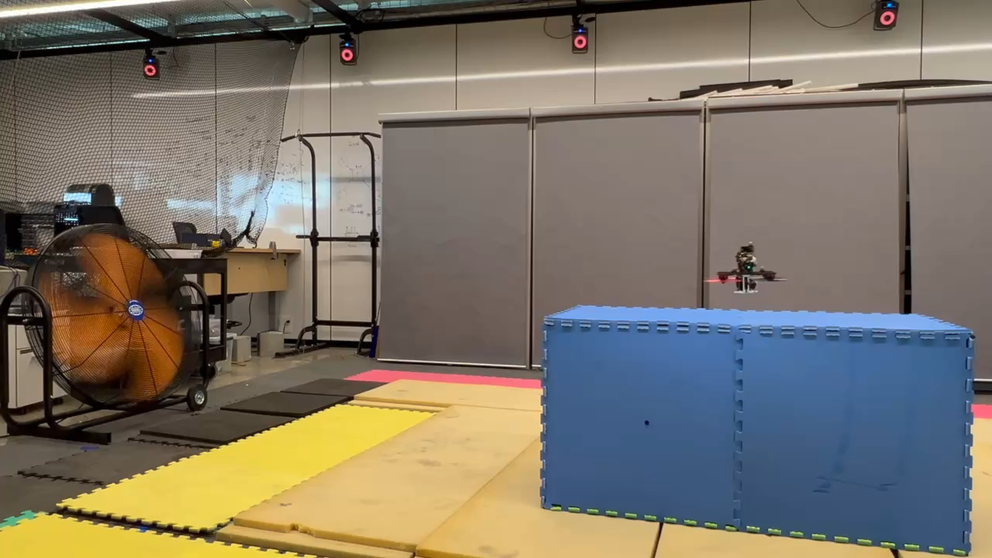
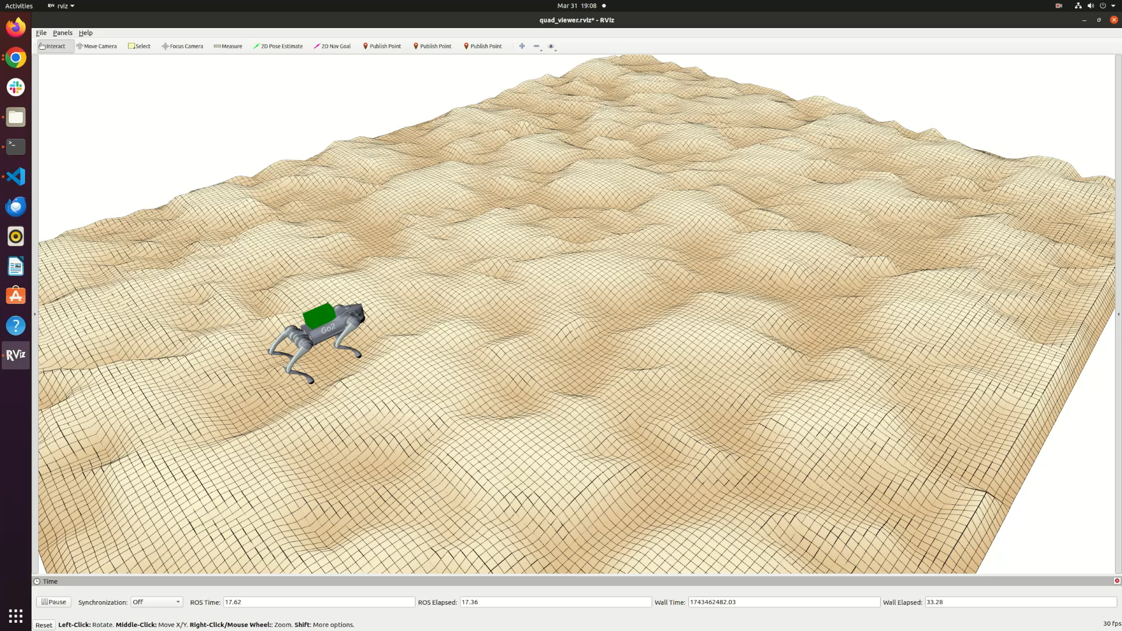
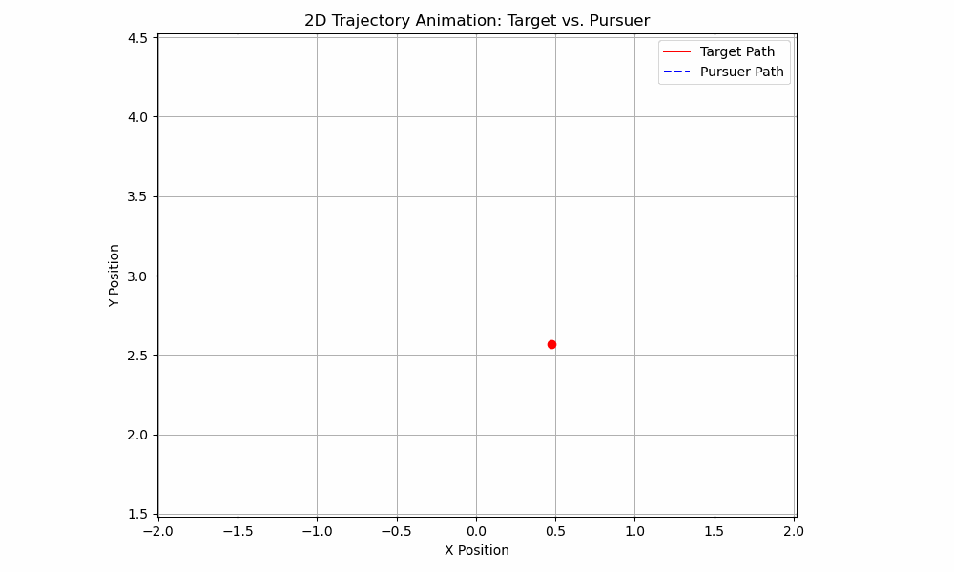
Summary & Extension
Self-supervised online control algorithm for:
simultaneous learning of Koopman Operators and model predictive control
no-dynamic-regret performance guarantees
Trajectory tracking under wind and ground effects
Trajectory tracking under unknown payload & rough terrain
Target tracking
with unknown motion
Extension:
Meta-learning of Koopman observables for generalization across domains & tasks
Uncertainty quantification for active and safe learning
Zhou and Tzoumas. "Simultaneous system identification and model predictive control with no dynamic regret." IEEE Transactions on Robotics (2025).
Zhou*, Zhang*, and Tzoumas. "Adaptive Legged Locomotion via Online Learning for Model Predictive Control." Under review.
Zhou*, Navsalkar*, and Tzoumas. "Online Learning for Tracking Targets with Unknown Dynamics." In preparation.

